Slide 1
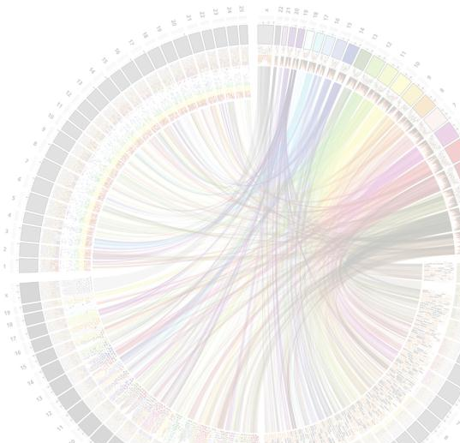


MSc in Bioinformatics
Module 4
Python programming for Structural Biology
Jaime Rodríguez Guerra, Jean-Didier Maréchal
Insilichem.bio
Department of Chemistry (UAB)
Course 2015-16

Slide 2
Introduction
What is python?
Python is an interpreted, object-oriented, high-level programming language with dynamic semantics. Its high-level built in data structures, combined with dynamic typing and dynamic binding, make it very attractive for Rapid Application Development, as well as for use as a scripting or glue language to connect existing components together.
Python's simple, easy to learn syntax emphasizes readability and therefore reduces the cost of program maintenance.
Python supports modules and packages, which encourages program modularity and code reuse.
The Python interpreter and the extensive standard library are available in source or binary form without charge for all major platforms, and can be freely distributed.

Slide 3
Why using python in Structural Biology?
Multiple Advantages:
From complex programming to one liner
Multiplatform
Fast
Easy, readable
Object = molecular concepts!

Slide 4
Python embedded Biomolecular platforms
Many suites are built on OR admit python inputs, outputs, analysis, implementation
Schrodinger
Pymol
Chimera
Etc.
Could be use:
To drive computation or for SCULPING
For accurate models or fast screening

Slide 5
UCSF Chimera and python
A core in C/C++
Basics function and objects
Fast but not easy to handle for quick access
Everything else in Python
The same command line and menu are python interpreted
IDLE gives access to the python sublevel
From here can drive complex modeling

Slide 6
Structural Objects in chimera
Model
i.e. models=chimera.openModels.list()[0]
Atoms
i.e. atoms=chimera.openModels.list()[0].atoms
Residues
???
Bonds
Etc…

Slide 7
Hands on!
From now on we will:
Move from menu to command line
From command line to script
Embed command line in scripts
Produce and have fun (hopefully)

